Slide 2
Extras

Slide 3
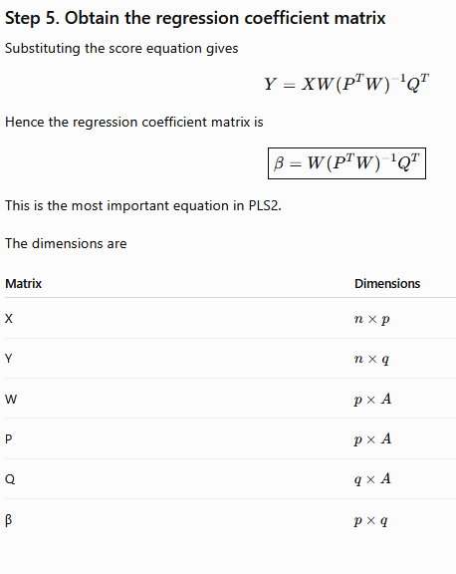
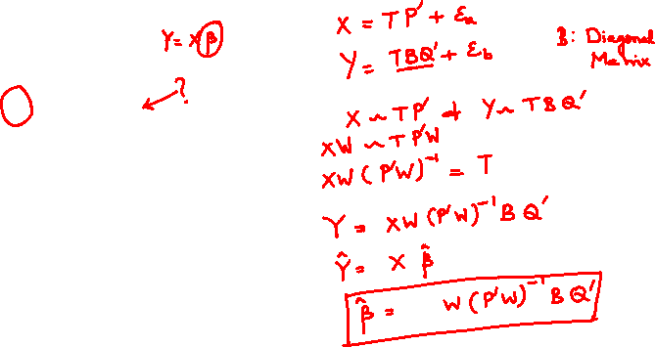

Slide 4
EndSem Portions
Introduction to MVDA
Types of variables – ratio, interval etc.
Types of missing data and methods of filling them and identifying outliers
Linear Regression
Linear Algebra
Statistical Distance
Partial least Squares Using NIPALS algorithm
Discriminant Analysis
Pen and Paper
All portions are there for endsem
3-page formulae sheet (3 sides NOT 6 sides of A4 paper)
Scientific calculator allowed
No mobile/smart watches
3 hours exam
No negative marking
Short answer type, qualitative and quantitative, problem solving

